Slide 1
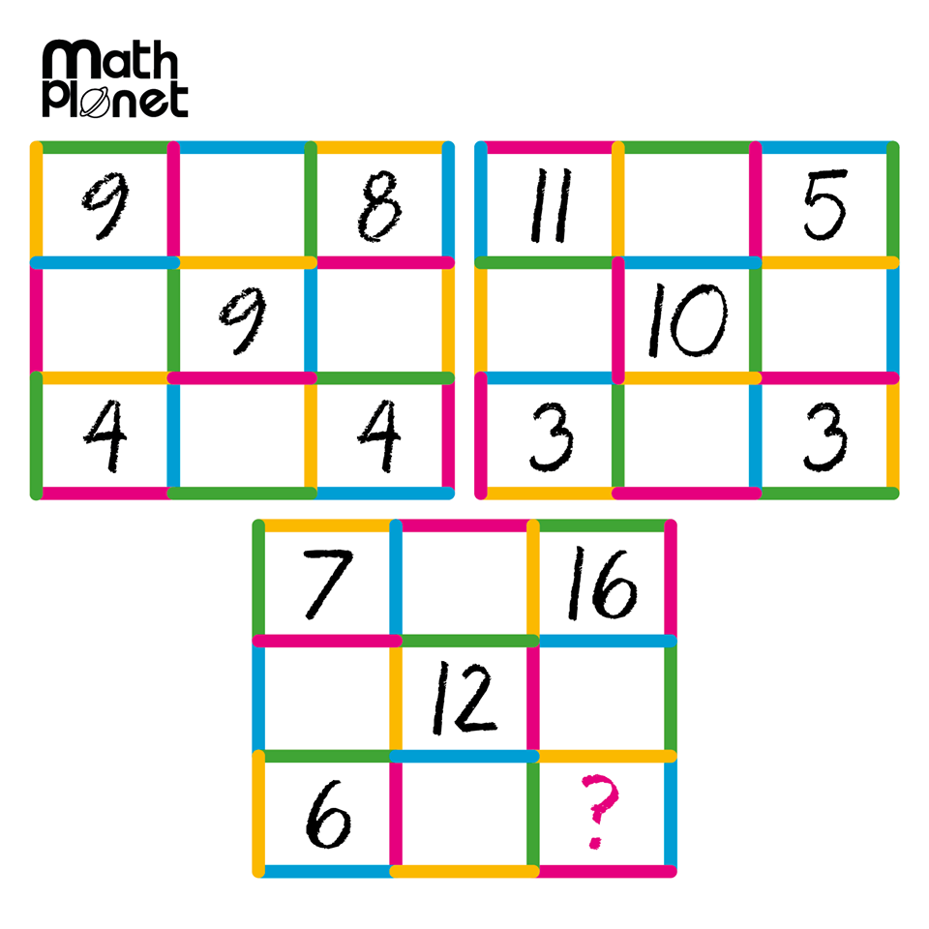
Today
Topic: Simple Interest
Everyone needs a calculator for today!!!
EQ: How do you solve for the other variables in the simple interest formula?
Mental warm up:
Chocolate for the first person to find the missing number

Slide 2
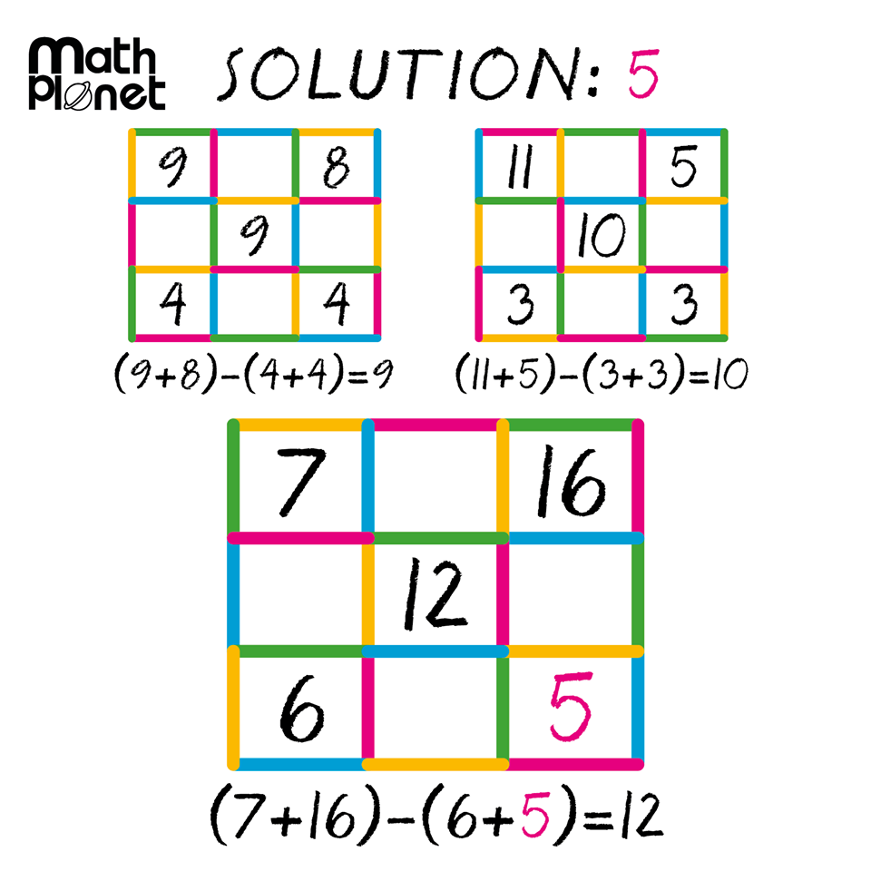

Slide 3
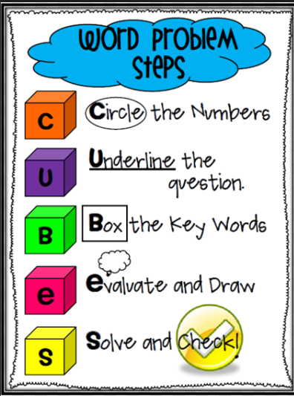
The CUBES method- we talk about this all the time!!!

Slide 4
Word Problem #1 – As a Class
Write on LHS of note book
Joe wants to borrow $2000 from a bank to buy a new car. He will take 2 years to pay the money back, and the bank’s interest rate is 8% per annum (per year).
How much simple interest does he pay?
How much does he pay altogether?
When solving word problems you need to list all your information systematically.
P =
R =
T =

Slide 5
Word Problem #2 Work with a partner
Susie borrows $4500 for a holiday. She expects to pay it off after 18 months. The bank charges 9% per annum interest.
How much interest does Susie pay?
How much does she pay altogether?
When solving word problems you need to list all your information systematically.
P =
R =
T =

Slide 6
Word Problem #3 Solo practice
Steph invests $6000 at 14% p.a. interest for 5 years.
How much did Steph earn?
Check with your shoulder partner!

Slide 7



Topic: Simple Interest
I = PRT
EQ: How do you solve for the other variables in the simple interest formula?
What is the subject?
Whatever is being solved for in the equation
In this equation simple interest is the subject but what if we wanted to find the rate? (or principal amount or time)
We need to re-arrange the equation using back-tracking
Backtracking uses opposite operations to find the unknown.
Opposite Operations
Addition and Subtraction
Multiplication and Division
How do we get a different subject?
I = PRT
We want to get P by itself. What operation is happening to P?
Make P the subject of the equation
It’s being multiplied by R and T
$$÷RT$$
$$÷RT$$
How do we undo multiplication? Division
$\frac{I}{RT}=P$
We have to do the EXACT same thing to both sides to keep the equation BALANCED

Slide 8









Topic: Simple Interest
I = PRT
EQ: How do you solve for the other variables in the simple interest formula?
I = PRT
Make P the subject of the equation
We want to get P by itself. What operation is happening to P?
$$÷RT$$
$$÷RT$$
It’s being multiplied by R and T
$\frac{I}{RT}=P$
How do we undo multiplication? Division
We have to do the EXACT same thing to both sides to keep the equation BALANCED
Make R the subject of the equation
I = PRT
$$÷PT$$
$$÷PT$$
$\frac{I}{PT}=$R
Make T the subject of the equation
I = PRT
$$÷PR$$
$$÷PR$$
$\frac{I}{PR}=T$

Slide 9
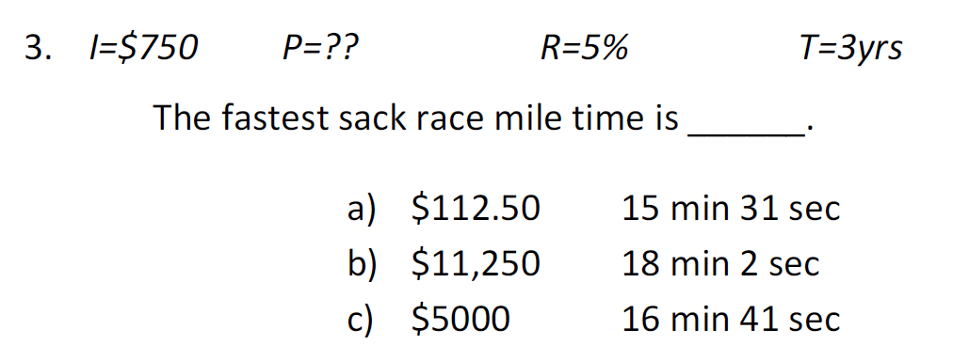
Get out your Fact Finder WS

Slide 10
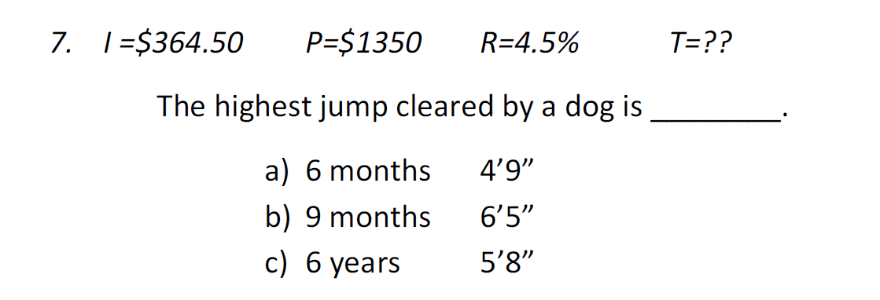

Slide 11
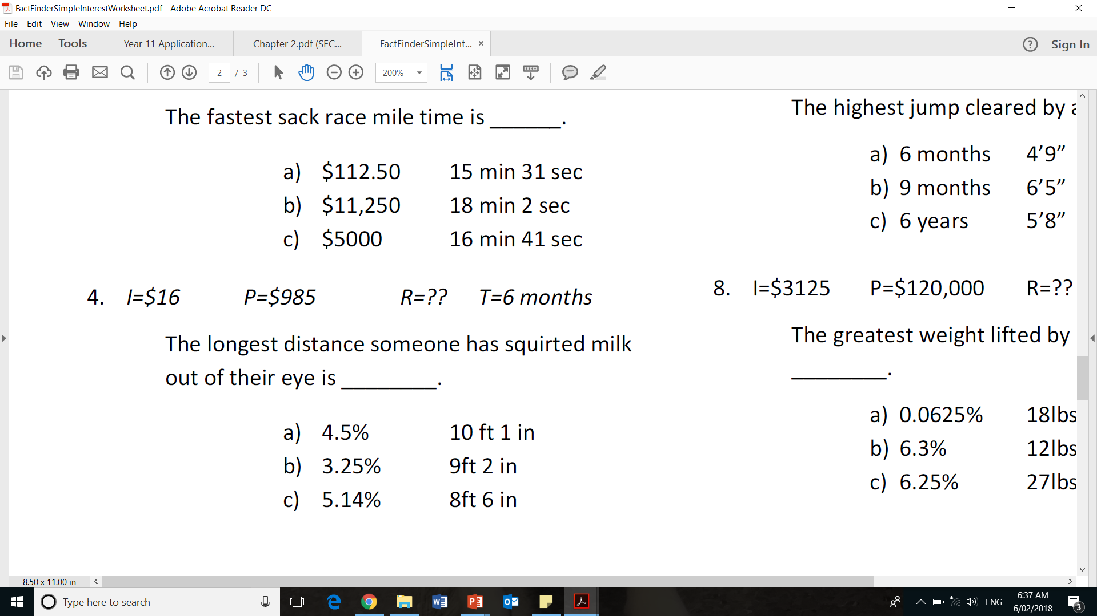

Slide 12
